Slide 1
Business Process – Accounts Payable

Slide 2
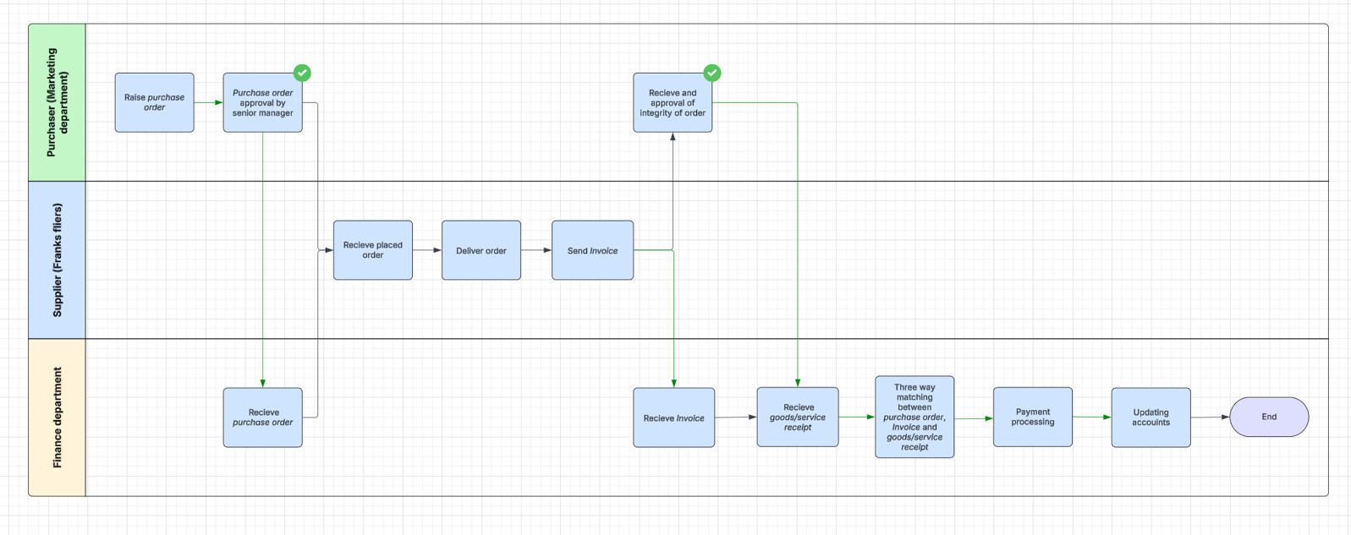
Accounts Payable Business Process 1.0

Slide 3
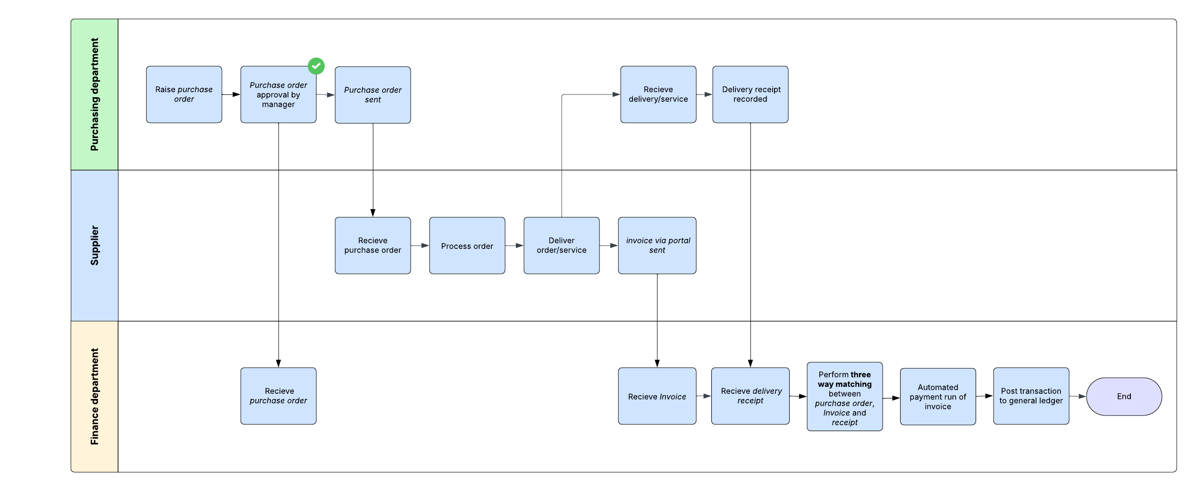
Accounts Payable Business Process 1.1

Slide 4
System Design

Slide 5
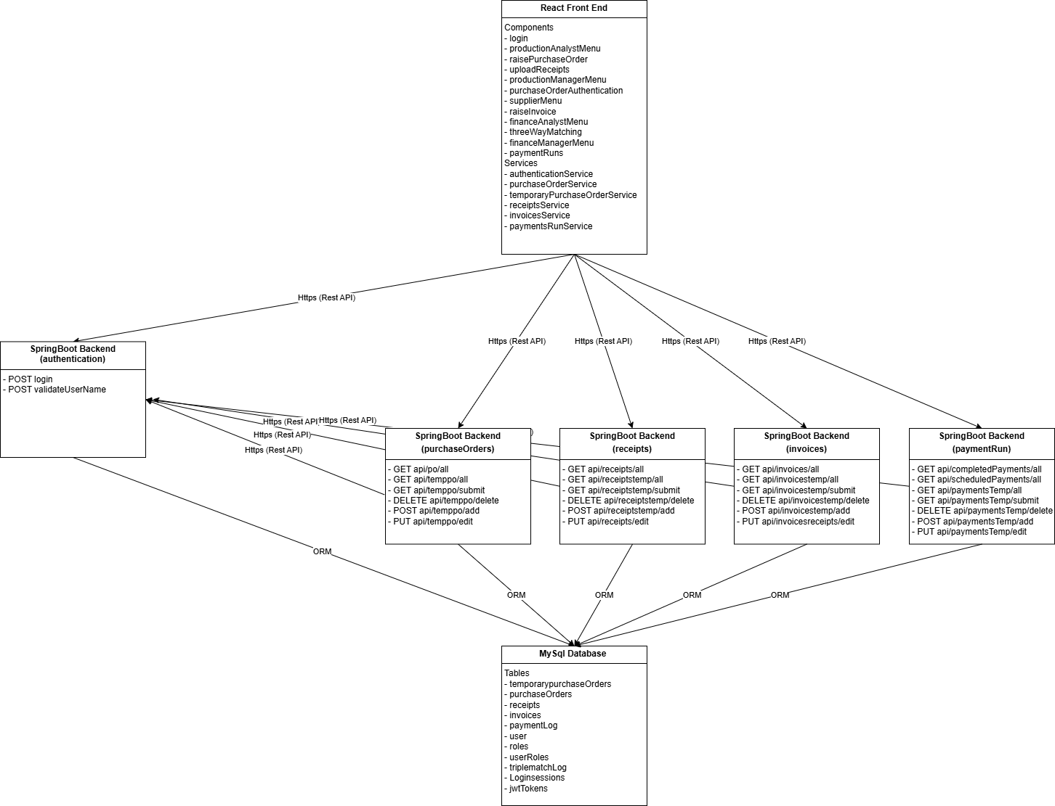
Web Application Component Diagram 1.0

Slide 6
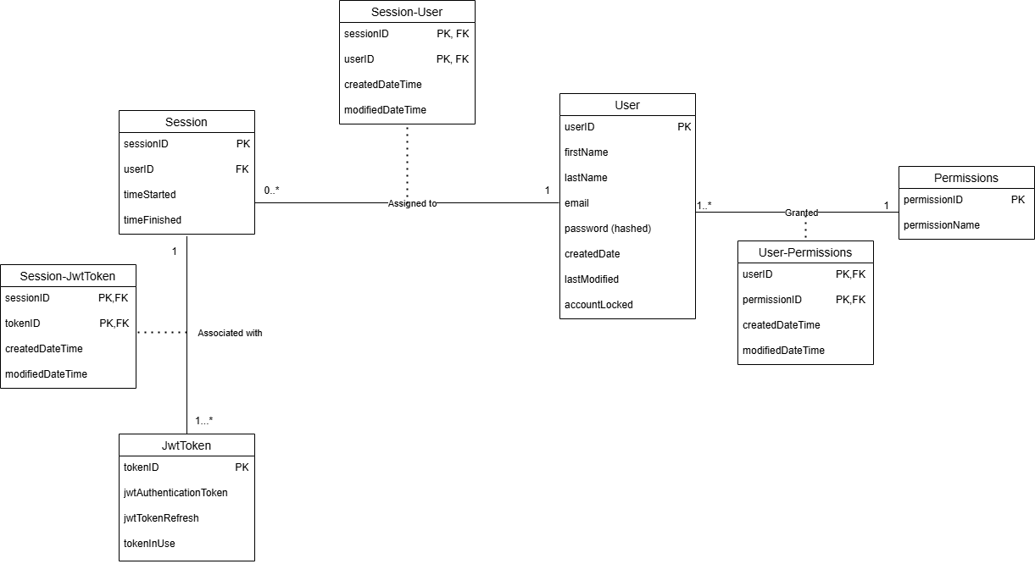
Database Design Diagram – Authentication 1.0

Slide 7
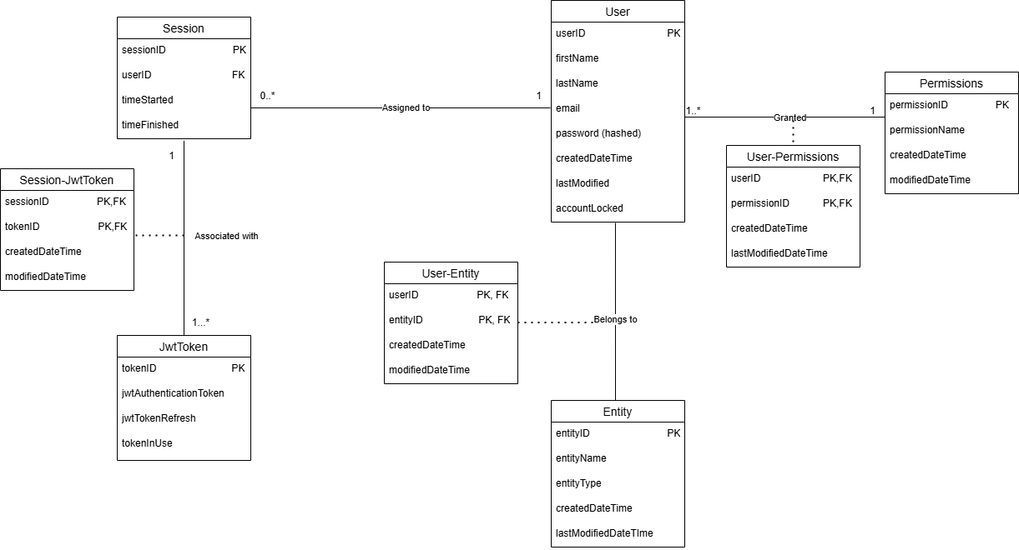
Database Design Diagram – Authentication 1.1

Slide 8
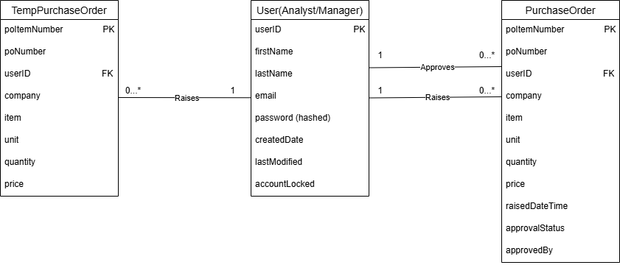
Database Design Diagram – Purchase Order 1.0

Slide 9
Database Design Diagram – Invoices

Slide 10
Database Design Diagram – TripleMatching

Slide 11
Database Design Diagram – PaymentRuns

Slide 12
API Sequence Diagrams

